Slide 1
SIT113 Cloud Computing and Virtualisation
Week 5, Class 1
Networking

Slide 2
Outline
Virtual Networking
Networking Clouds

Slide 3
Virtual Networking
Network Interface Cards (NICs) and Switches
Virtual Network Interface Cards
Virtual Switches
Additional Abstraction Layer

Slide 4
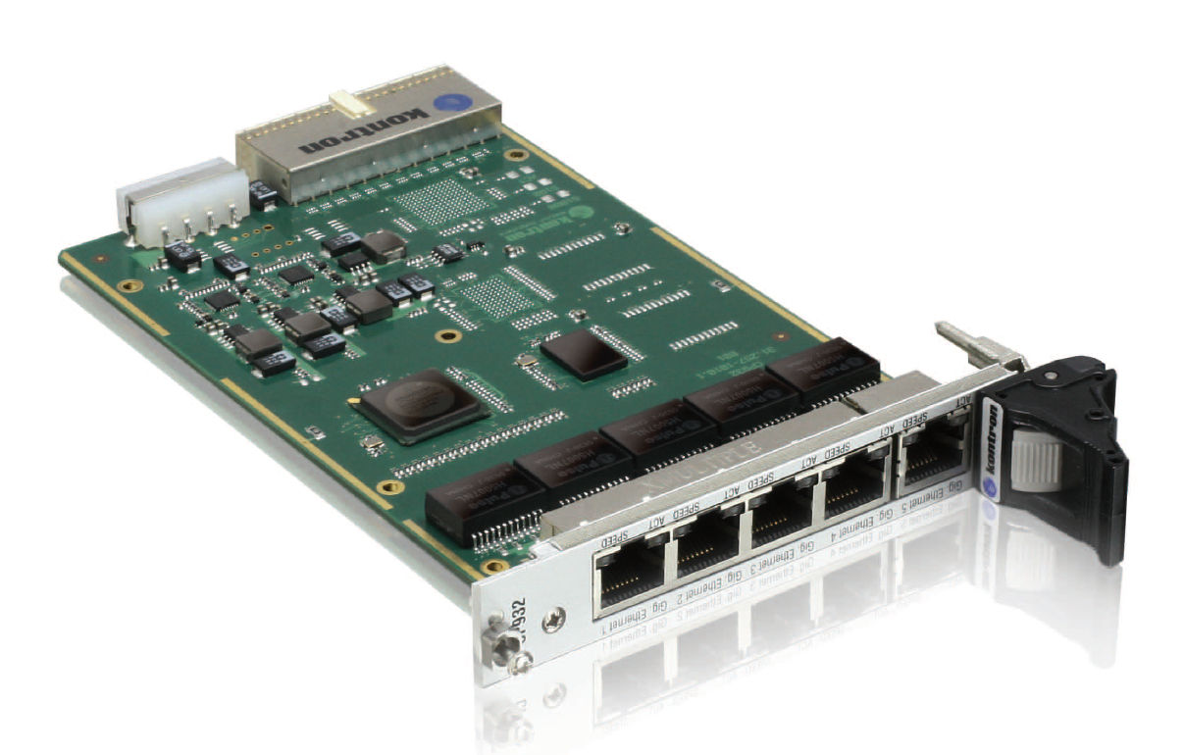
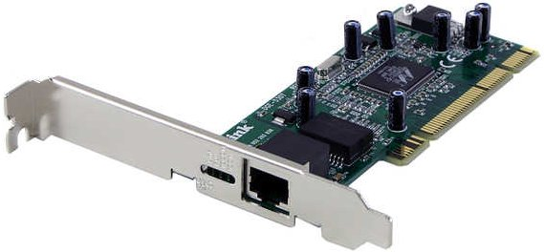
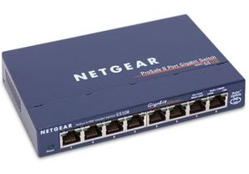
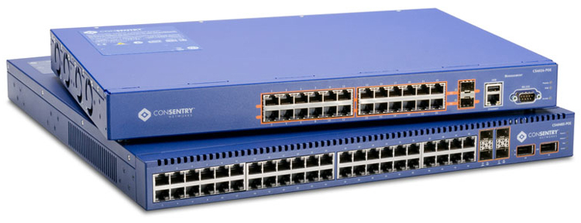
Network Interface Cards (NICs) and Switches

Slide 5
Virtual Networking: Virtual Network Interface Cards
A virtual NIC (vNIC) mimics a physical NIC (pNIC)
When configuring a virtual machine (VM), the virtual hardware can include 0 or more vNICs
vNICs are connected to vSwitches

Slide 6
Virtual Networking: Virtual Switches
A vSwitch mimics a pSwitch
There are some minor differences such as how MAC addresses are learned
pSwitches learn by monitoring traffic
vSwitches already know MAC addresses of connected VMs
What is a MAC address?

Slide 7
What is MAC? Remote Packet Delivery
Packets are sent to IP addresses of remote systems.
Each IP address is a 32-bit number but is written as four 8-bit numbers such as:
128.184.216.200
10.115.171.201
Humans might remember names such as:
www.deakin.edu.au
10F5PC0C14PZ.du.deakin.edu.au

Slide 8
What is MAC? DNS Protocol
DNS = Domain Name System
DNS translates a name into an IP address
IP address = DNS(name)
For example:
128.184.216.200 = DNS(www.deakin.edu.au)
10.115.171.201 = DNS(10F5PC0C14PZ.du.deakin.edu.au)

Slide 9
What is MAC? Local Packet Delivery
Packets are sent to MAC addresses on a LAN.
MAC address = Media Access Control address is a unique identifier assigned to a network interface.
ARP = Address Resolution Protocol
ARP translates an IP address into a MAC address
MAC address = ARP(IP address)
For example,
6C-0B-84-6D-EA-7D = ARP(10.115.171.201)

Slide 10
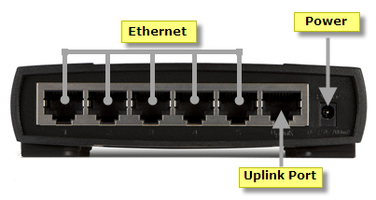
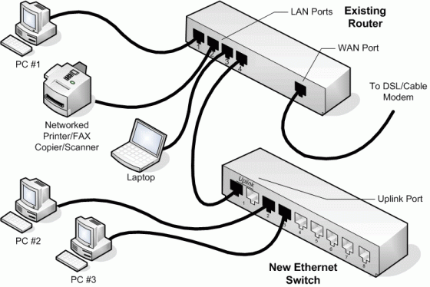
Virtual Networking: Virtual Switches
pSwitches are limited by the number of ports (how many cables can be plugged in)
vSwitches are not limited
pSwitches include an “uplink port”
Notes:
The uplink port on a router is used to expand the network. Routers can use the uplink port to connect to other routers, switches and hubs to increase the maximum number of wired devices connected to the network.
An uplink is a connection from a device or smaller local network to a larger network.

Slide 11
Virtual Networking: Example
Consider the following physical topology

Slide 12
Virtual Networking: Example
The same topology can be represented using virtual networking:

Slide 13
Virtual Networking: Additional Abstraction Layer
Using vNICs and vSwitches provides an additional abstraction layer
Allows pNICs to be shared by multiple VMs
Allows vSwitches to be distributed across multiple physical hosts (the virtual network topology on the previous slide could be on one or more physical hosts)

Slide 14
Virtual Networking: Additional Abstraction Layer
Allows traffic to be captured (for VM snapshots, live backups, etc.)
Allows traffic to be redirected (for VM/storage migration)
Allows traffic for one cloud consumer to be effectively isolated from other cloud consumers
Allows traffic generated by a VM to be carefully filtered before reaching the physical networks

Slide 15
Virtual Networking: Virtual Standard and Distributed Switches
Each vSphere Standard Switch (VSS):
contains a data plane
contains a management plane
is configured and maintained individually
VSSs are grouped into one VDS.
each data plane is local to each VSS
but the management plane is centralized

Slide 16
Networking Clouds
Existing Technologies
Other Technologies
VLANs
Private VLANs
Software Defined Networking (SDN)
Why is SDN useful?

Slide 17
Networking Clouds: Existing Technologies
Networking infrastructure for building clouds is merely an extension of existing technologies
Construction of clusters in the data centre are supported by very high speed networks
Link aggregation for high throughput
LAN/WAN redundancy for high availability
Software Defined Networking for programming a network

Slide 18
Networking Clouds: Other Technologies
Very large physical hosts can have many high speed NICs
Problem: Each time data is received or successfully sent, the NIC will send an interrupt to the CPU for the operating system (hypervisor)
Each interrupt causes some overhead, slightly reducing performance
Many interrupts can greatly reduce performance

Slide 19
Networking Clouds: Other Technologies
Three solutions:
VLANs
Private VLANs
Software Defined Networking

Slide 20
Networking Clouds: VLANs
each NIC can receive data from one or more VLANs
minimising this number:
reduces unnecessary traffic
improves performance

Slide 21
Networking Clouds: Private VLANs
isolates network traffic using three port types:
Promiscuous ports: communicate with all other ports in the VLAN
Isolated ports: only communicate with promiscuous ports
Community ports: only communicate with promiscuous ports and other ports in the same community

Slide 22
Networking Clouds: Private VLANs
 | Promiscuous ports | Isolated ports | Ports in Community A | Ports in Community B
Promiscuous ports | Allow | Allow | Allow | Allow
Isolated ports | Allow
Ports in Community A | Allow |  | Allow
Ports in Community B | Allow |  |  | Allow

Slide 23
Networking Clouds: Software Defined Networking (SDN)
Functionality in a physical network device, e.g., a switch, can be roughly divided into:
Data plane: functionality for forwarding data through the device
Control plane: computes how data is forwarded, providing that information to the data plane (e.g., route calculations)
Management plane: functionality for network administrators to monitor and configure

Slide 24
Networking Clouds: Software Defined Networking (SDN)
SDN aims to:
move the control plane out of the physical device and into software

Slide 25
Networking Clouds: Why is SDN useful?
Historically networks were static
Administrators manually configured new devices
Networks rarely change, once operational
As a result, network configuration management was a very carefully planned and controlled process

Slide 26
Networking Clouds: Why is SDN useful?
Consider cloud computing:
New VMs easily deployed with a few mouse clicks
VMs migration, manually or automatically
As VM migrate, communication paths move
Isolate traffic of one cloud consumer from others
The network is constantly changing (it is no longer static).

Slide 27
Summary
Virtual Networking
Networking Clouds

